Slide 1

Coding with Intelligence
Presented by:
John Dohoney, Jr.
SDP, US West

Slide 2

What does Copilot do for you
Prompting
How do you squeeze the most out of Co-Pilot
Labs
CoPilot Setup and CodeSpaces

Slide 3

Prompts by John Dohoney
Image Creation by DALL-E
https://www.bing.com/images/create

Slide 4

co·pi·lot (ˈkōˌpīlət/) a qualified pilot who assists or relieves the pilot but is not in command
The design pattern for Microsoft/Github AI tools

Slide 5

Tips for Using GitHub Copilot
Know that it's a copilot, not an autopilot
Copilot augments your productivity, but you remain in the driver's seat
Use Copilot as a source of inspiration and guidance, then use your own creativity, logic, and judgment before acting or finalizing
Copilot is a co-creator, not a solo artist!
Copilot is an augmentation, not an automation
It is designed to help you, not to replace you
Always review and edit the outputs before using them for your purposes
Notes:
Having the right expectations and mindset is essential for using M365 Copilot. It's a digital assistant that uses human language, but it doesn't think, feel, or learn. It's a powerful tool, but it needs context and clear instructions to help you. Copilot is a copilot, not an autopilot - it augments your productivity, but you remain in the driver's seat. It's an augmentation, not an automation - it is designed to help you, not to replace you. Always review and edit the outputs before using them for your purposes. Original Content: Mindset Having the right expectations and mindset is important to your first interactions with M365 Copilot. Copilot is a digital assistant that uses human language, but it doesn t think, feel, or learn. Its context about your needs is limited to your current conversation. M365 Copilot is a very powerful tool, but it can t read minds. Think of M365 Copilot as the world s smartest personal assistantintern [KS10] on their first day. Your assistantIt [KS11] iis very intelligent and capable but it doesn t know how you think, so the more context and clarity you give it, the better it can help youwill your need context and clear instructions in order to best help you[KS12] .. You[MY13] [ME14] will need to state your goal[KS15] , turn the implicit into explicit, and organize work into multiple steps. It s also meant to be iterative, so you work alongside the AI Copilot works best when you give it the chance to build on itself, so don t hesitate to let it know when you were looking for something different or more. This is a new skill and there is a learning curve. To harness its full potential, embrace the right mindset. Here s how to approach using M365 Copilot to are essential our tried and tested tips to unleash M365 Copilotit's magic: Know that it s a copilot, not an autopilot. Copilot augments your productivity, but you remain in the driver s seat. The LLMs and the data Copilot uses have limits. Use Copilot as a source of inspirati

Slide 6

Collaborating with Copilot for Better Results
Copilot is a co-creator, not a solo artist - collaborate with it, provide feedback, and iterate on the results.
Use your own creativity, logic, and judgment to improve the outputs.
Optimize the ingredients of your prompt to Copilot.
Copilot is a learn-it-all, not a know-it-all - be open to learning and experimenting.
Use friendly language like you would with a colleague to get better results.
Be polite - using polite professional language helps improve quality.
If at first you don't succeed, try again - embrace your learning curve and remain flexible.
Notes:
Copilot is best used when you collaborate with it, provide feedback, and iterate on the results. You should also use your own creativity, logic, and judgment to improve the outputs. It's important to optimize the ingredients of your prompt to Copilot. The model is learning from your inputs, so be open to learning and experimenting with Copilot and try different things to see what works best. Use friendly language like you would with a colleague to get better results. Be polite and use polite professional language to help improve quality. If at first you don't succeed, try again. Embrace your learning curve, remain flexible, and try more than one approach. Original Content: Copilot is a co-creator, not a solo artist. It works best when you collaborate with it, provide feedback, and iterate on the results. You should also use your own creativity, logic, and judgment to improve the outputs. <should we point to the WTI here on the skills needed for AI Aptitude?>Use the best ingredients. You ll unlock more value when you optimize the ingredients of your prompt to Copilot (see next section) Copilot is a learn-it-all, not a know-it-all. The model is learning from your inputs. You should also be open to learning and experimenting with Copilot and try different things to see what works best.[KS17] [ME18] Copilot is a partner. Use friendly language like you would with a colleague to get better results. Rude, abusive, or slang language can cause confusion in the large language model (LLM).[KS19] [ME20] [MY21] Be polite. Using polite professional language helps improve quality, not because Copilot has feelings, but because the LLMs responses reflect the probability of how a human would respond. If at first you don t succeed, try again. Copilot is based on stable yet constantly evolving technology. Embrace your learning curve, remain flexible, and try more than one approach.

Slide 7
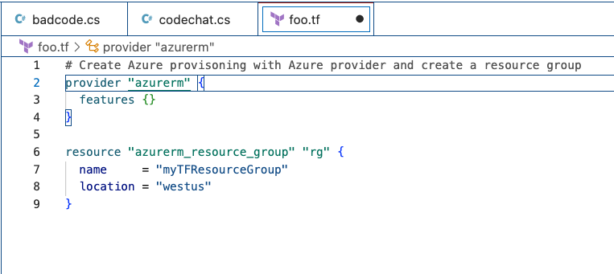






OpenAI Codex
Prompting
Be specific
Be clear about what you want done
The more information, the better the result
Operates off plain English – no special syntax
Context
Prompts and Suggestions

Slide 8
Prompting – Best Practices
Set the stage with a High-Level Goal
This is most helpful if you have a blank file or empty codebase. In other words, if GitHub Copilot has zero context of what you want to build or accomplish, setting the stage for the AI pair programmer can be really useful. It helps to prime GitHub Copilot with a big picture description of what you want it to generate—before you jump in with the details.
When prompting GitHub Copilot, think of the process as having a conversation with someone: How should I break down the problem so we can solve it together? How would I approach pair programming with this person?

Slide 9
Prompting – Best Practices
Make your ask simple and specific. Aim to receive short output from GitHub Copilot
Once you communicate your main goal to the AI pair programmer, articulate the logic and steps it needs to follow for achieving that goal. GitHub Copilot better understands your goal when you break things down.
(Imagine you’re writing a recipe. You’d break the cooking process down into discrete steps–not write a paragraph describing the dish you want to make.)
Let GitHub Copilot generate the code after each step, rather than asking it to generate a bunch of code all at once.

Slide 10
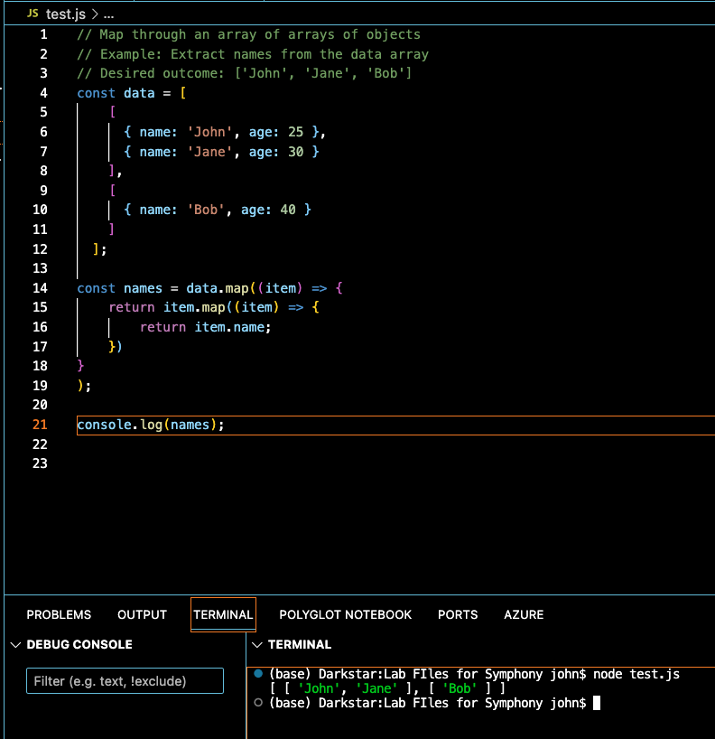
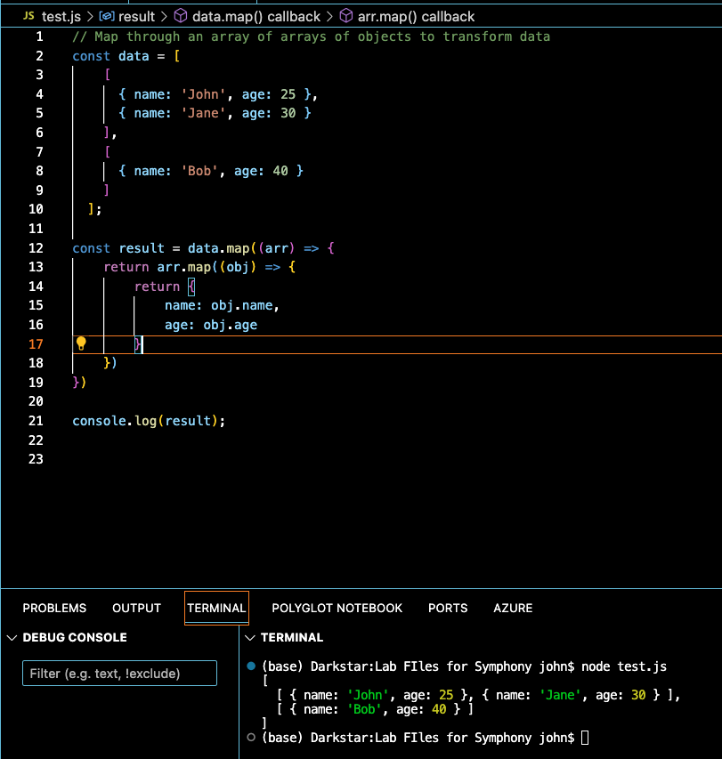
Prompting – Best Practices
Give GitHub Copilot an example or two
Learning from examples is not only useful for humans, but also for your AI pair programmer.

Slide 11
Prompting – Basics
Experiment with your prompts.
Just how conversation is more of an art than a science, so is prompt crafting. So, if you don’t receive what you want on the first try, recraft your prompt by following the best practices in the previous slides.
Keep a couple of relevant tabs open
No exact number of tabs is documented that you should keep open to help GitHub Copilot contextualize your code, but from my experience, I found that one or two is helpful.
GitHub Copilot uses a technique called neighboring tabs that allows the AI pair programmer to contextualize your code by processing all of the files open in your IDE instead of just the single file you’re working on. However, it’s not guaranteed that Github Copilot will deem all open files as necessary context for your code.
Use good coding practices.
Provide descriptive variable names and functions. Follow consistent coding styles and patterns. I’ve found that working with GitHub Copilot encourages me to follow good coding practices learned throughout my development career.

Slide 12




What does Copilot do best
Code Conversion
Pair Programming
Test Case Coverage advisor
Refactoring Assistant

Slide 13
Prompting Exercise – With Dall-E

Slide 14

Labs
Setting up CoPilot on CodeSpaces
Copilot and Infrastructure as Code (IAC)
Copilot and Python, APIFlask, and OpenAPI
CoPilot and Machine Learning

